Slide 1
Unit 3 Wireless Transmission Fundamentals
Preeti Godabole

Slide 2
Topics
Introduction to narrow and wideband systems;
Spread spectrum;
Frequency hopping;
Introduction to MIMO;
MIMO Channel Capacity and diversity gain;
Introduction to OFDM; MIMO-OFDM system;
Multiple access control (FDMA, TDMA, CDMA, SDMA);
Wireless local area network;
Wireless personal area network (Bluetooth and ZigBee)

Slide 3
Goal of WLANs is to replace office cabling, to enable tetherless access to the internet and, to introduce a higher flexibility for ad-hoc communication in, e.g., group meetings.

Slide 4
Wireless networks
Access computing/communication services, on the move
Cellular Networks
traditional base station infrastructure systems
Wireless LANs
infrastructure as well as ad-hoc networks possible
very flexible within the reception area
low bandwidth compared to wired networks (1-10 Mbit/s)
Multihop Ad hoc Networks
useful when infrastructure not available, impractical, or expensive
military applications, rescue, home networking

Slide 5
Cellular Wireless
Single hop wireless connectivity to the wired world
Space divided into cells, and hosts assigned to a cell
A base station is responsible for communicating with hosts/nodes in its cell
Mobile hosts can change cells while communicating
Hand-off occurs when a mobile host starts communicating via a new base station

Slide 6
Evolution of cellular networks
First-generation: Analog cellular systems (450-900 MHz)
Frequency shift keying; FDMA for spectrum sharing
NMT (Europe), AMPS (US)
Second-generation: Digital cellular systems (900, 1800 MHz)
TDMA/CDMA for spectrum sharing; Circuit switching
GSM (Europe), IS-136 (US), PDC (Japan)
<9.6kbps data rates
2.5G: Packet switching extensions
Digital: GSM to GPRS; Analog: AMPS to CDPD
<115kbps data rates
3G: Full-fledged data services
High speed, data and Internet services
IMT-2000, UMTS
<2Mbps data rates

Slide 7
Characteristics of wireless LANs
Advantages
very flexible within the reception area
Ad-hoc networks without previous planning possible
(almost) no wiring difficulties (e.g. historic buildings, firewalls)
more robust against disasters like, e.g., earthquakes, fire - or users pulling a plug...
Disadvantages
typically very low bandwidth compared to wired networks (1-10 Mbit/s)
many proprietary solutions, especially for higher bit-rates, standards take their time (e.g. IEEE 802.11)
products have to follow many national restrictions if working wireless, it takes a vary long time to establish global solutions like, e.g., IMT-2000
safety and security -may interfere with the equipments , eavesdropping much easier

Slide 8
Design goals for wireless LANs
global, seamless operation
low power for battery use
no special permissions or licenses needed to use the LAN
robust transmission technology
simplified spontaneous cooperation at meetings
easy to use for everyone, simple management
protection of investment in wired networks
security (no one should be able to read my data), privacy (no one should be able to collect user profiles), safety (low radiation)
transparency concerning applications and higher layer protocols, but also location awareness if necessary

Slide 9
Comparison: infrared vs. radio transmission
Infrared
uses IR diodes, diffuse light, multiple reflections (walls, furniture etc.)
Advantages
simple, cheap, available in many mobile devices
no licenses needed
simple shielding possible
Disadvantages
interference by sunlight, heat sources etc.
many things shield or absorb IR light
low bandwidth
Example
IrDA (Infrared Data Association) interface available everywhere
Radio
typically using the license free ISM band at 2.4 GHz
Advantages
experience from wireless WAN and mobile phones can be used
coverage of larger areas possible (radio can penetrate walls, furniture etc.)
Disadvantages
very limited license free frequency bands
shielding more difficult, interference with other electrical devices
Example
WaveLAN, HIPERLAN, Bluetooth

Slide 10
Wireless LANs
Infrared (IrDA) or radio links (Wavelan)
Advantages
very flexible within the reception area
Ad-hoc networks possible
(almost) no wiring difficulties
Disadvantages
low bandwidth compared to wired networks
many proprietary solutions
Bluetooth, HiperLAN and IEEE 802.11

Slide 11
Wireless LANs vs. Wired LANs
Destination address does not equal destination location
The media impact the design
wireless LANs intended to cover reasonable geographic distances must be built from basic coverage blocks
Impact of handling mobile (and portable) stations
Propagation effects
Mobility management
Power management

Slide 12
Infrastructure vs. Ad hoc WLANs
infrastructure network
AP: Access Point
AP
AP
wired network
AP
ad-hoc network
Source: Schiller

Slide 13
Multi-Hop Wireless
May need to traverse multiple links to reach destination
Mobility causes route changes

Slide 14
Mobile Ad Hoc Networks (MANET)
Do not need backbone infrastructure support
Host movement frequent
Topology change frequent
Multi-hop wireless links
Data must be routed via intermediate nodes
B
A
A
B

Slide 15
Applications of MANETS
Military - soldiers at Kargil, tanks, planes
Disaster Management – Orissa, Gujarat
Emergency operations – search-and-rescue, police and firefighters
Sensor networks
Taxicabs and other closed communities
airports, sports stadiums etc. where two or more people meet and want to exchange documents
Presently MANET applications use 802.11 hardware
Personal area networks - Bluetooth

Slide 16
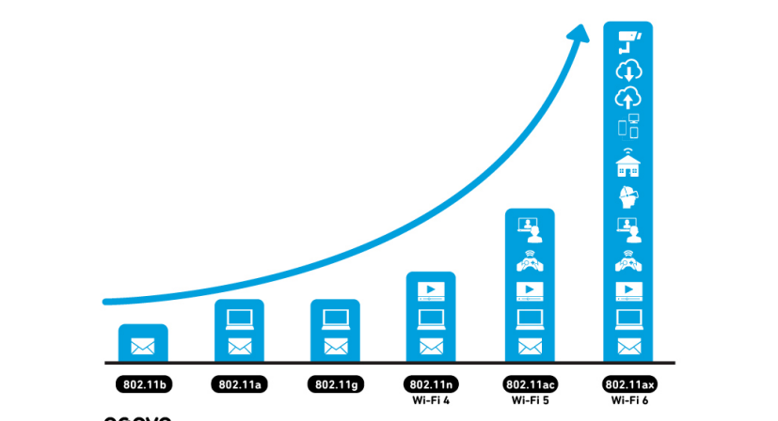
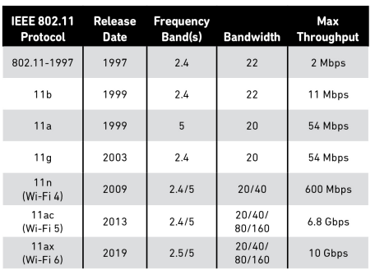
Wireless Lan 802.11 Evolution

Slide 17
Challenges of Wireless Communications

Slide 18
Wireless Media
Physical layers used in wireless networks
have neither absolute nor readily observable boundaries outside which stations are unable to receive frames are unprotected from outside signals
communicate over a medium significantly less reliable than the cable of a wired network
have dynamic topologies
lack full connectivity and therefore the assumption normally made that every station can hear every other station in a LAN is invalid (i.e., STAs may be “hidden” from each other)
have time varying and asymmetric propagation properties

Slide 19
Limitations of the mobile environment
Limitations of the Wireless Network
limited communication bandwidth
frequent disconnections
heterogeneity of fragmented networks
Limitations Imposed by Mobility
route breakages
lack of mobility awareness by system/applications
Limitations of the Mobile Device
short battery lifetime
limited capacities

Slide 20
Wireless v/s Wired networks
Regulations of frequencies
Limited availability, coordination is required
useful frequencies are almost all occupied
Bandwidth and delays
Low transmission rates
few Kbps to some Mbps.
Higher delays
several hundred milliseconds
Higher loss rates
susceptible to interference, e.g., engines, lightning
Always shared medium
Lower security, simpler active attacking
radio interface accessible for everyone
Fake base stations can attract calls from mobile phones
secure access mechanisms important

Slide 21
Difference Between Wired and Wireless
Ethernet LAN
Wireless LAN
B
A
B
C
A
C
If both A and C sense the channel to be idle at the same time, they send at the same time.
Collision can be detected at sender in Ethernet.
Half-duplex radios in wireless cannot detect collision at sender.

Slide 22
Effect of mobility on protocol stack
Application
new applications and adaptations
Transport
congestion and flow control
Network
addressing and routing
Link
media access and handoff
Physical
transmission errors and interference

Slide 23
802.11-based Wireless LANs Architecture and Physical Layer
The primary goal of the standard was the specification of a simple and robust WLAN which offers time-bounded and asynchronous services.
The MAC layer should be able to operate with multiple physical layers, each of which exhibits a different medium sense and transmission characteristic

Slide 24
Components of IEEE 802.11 architecture
The basic service set (BSS) is the basic building block of an IEEE 802.11 LAN
The ovals can be thought of as the coverage area within which member stations can directly communicate
The Independent BSS (IBSS) is the simplest LAN. It may consist of as few as two stations
ad-hoc network
BSS1
BSS2

Slide 25
802.11 - infrastructure network
Station (STA)
terminal with access mechanisms to the wireless medium and radio contact to the access point
Basic Service Set (BSS)
group of stations using the same radio frequency
Access Point
station integrated into the wireless LAN and the distribution system Portal bridge to other (wired) networks
Distribution System
interconnection network to form one logical network (EES: Extended Service Set) based on several BSS
802.11 LAN
802.x LAN
STA₁
BSS₁
Access
Point
Portal
Distribution System
ESS
Access
Point
BSS₂
STA₂
802.11 LAN
STA₃
Source: Schiller
Notes:
9

Slide 26
802.11 - ad-hoc network
802.11 LAN
Direct communication within a limited range
Station (STA): terminal with access mechanisms to the wireless medium
Basic Service Set (BSS): group of stations using the same radio frequency
STA₁
BSS₁
STA₃
STA₂
BSS₂
STA₅
STA₄
802.11 LAN
Source: Schiller

Slide 27
Distribution System (DS) concepts
The Distribution system interconnects multiple BSSs
802.11 standard logically separates the wireless medium from the distribution system – it does not preclude, nor demand, that the multiple media be same or different
An Access Point (AP) is a STA that provides access to the DS by providing DS services in addition to acting as a STA.
Data moves between BSS and the DS via an AP
The DS and BSSs allow 802.11 to create a wireless network of arbitrary size and complexity called the Extended Service Set network (ESS)

Slide 28
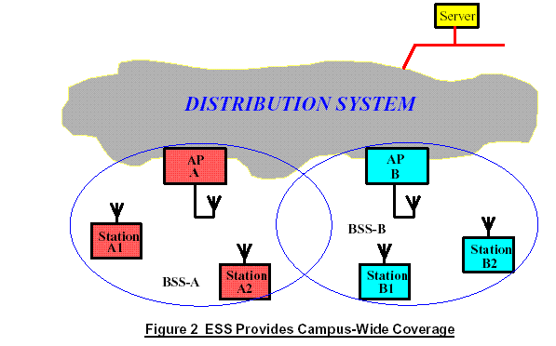
Extended Service Set network
Source: Intersil

Slide 29
802.11- in the TCP/IP stack
fixed terminal
mobile terminal
server
infrastructure network
access point
application
application
TCP
TCP
IP
IP
LLC
LLC
LLC
802.11 MAC
802.11 MAC
802.3 MAC
802.3 MAC
802.11 PHY
802.11 PHY
802.3 PHY
802.3 PHY

Slide 30
802.11 - Layers and functions
PLCP Physical Layer Convergence Protocol
clear channel assessment signal (carrier sense)
PMD
Physical Medium Dependent modulation, coding
PHY Management
channel selection, MIB
Station Management
coordination of all management functions
MAC
access mechanisms, fragmentation, encryption
MAC Management
synchronization, roaming, MIB, power management
Station Management
LLC
DLC
MAC
MAC Management
PLCP
PHY Management
PHY
PMD

Slide 31
IEEE 802.11
Wireless LAN standard defined in the unlicensed spectrum (2.4 GHz and 5 GHz U-NII bands)
Standards covers the MAC sublayer and PHY layers
Three different physical layers in the 2.4 GHz band
FHSS, DSSS and IR
OFDM based Phys layer in the 5 GHz band (802.11a)
λ
33cm
12cm
5cm
26 MHz
83.5 MHz
200 MHz
902 MHz
2.4 GHz
5.15 GHz
928 MHz
2.4835 GHz
5.35 GHz

Slide 32
802.11 - Physical layer
All PHY variants include the provision of the clear channel assessment signal (CCA). This is needed for the MAC mechanisms controlling medium access and indicates if the medium is currently idle
The PHY layer offers a service access point (SAP) with 1 or 2 Mbit/s transfer
rate to the MAC layer (basic version of the standard).
3 versions of spread spectrum:
2 radio (typ. 2.4 GHz),
1 IR data rates 1 or 2 Mbps
1.FHSS (Frequency Hopping Spread Spectrum)
spreading, despreading, signal strength, typically 1 Mbps min. 2.5 frequency hops/s (USA), two-level GFSK modulation

Slide 33


FHSS PHY packet format
Synchronization
synch with 010101... pattern
SFD (Start Frame Delimiter)
0000110010111101 start pattern
PLW (PLCP_PDU Length Word)
length of payload incl. 32 bit CRC of payload, PLW < 4096
PSF (PLCP Signaling Field)
data of payload (1 or 2 Mbit/s)
HEC (Header Error Check)
CRC with x¹⁶+x¹²+x⁵+1
80
16
12
4
16
variable
bits
synchronization
SFD
PLW
PSF
HEC
payload
PLCP preamble
PLCP header

Slide 34

2.DSSS (Direct Sequence Spread Spectrum)
DBPSK modulation for 1 Mbps (Differential Binary Phase Shift Keying), DQPSK for 2 Mbps (Differential Quadrature PSK)
preamble and header of a frame is always transmitted with 1 Mbps, rest of transmission 1 or 2 Mbps
chipping sequence: +1, -1, +1, +1, -1, +1, +1, +1, -1, -1, -1 (Barker code)
max. radiated power 1 W (USA), 100 mW (EU), min. 1mW
3.Infrared
850-950 nm, diffuse light, typ. 10 m range
carrier detection, energy detection, synchronization

Slide 35

DSSS PHY packet format
Synchronization
synch., gain setting, energy detection, frequency offset compensation
SFD (Start Frame Delimiter)
1111001110100000
Signal
data rate of the payload (0A: 1 Mbit/s DBPSK; 14: 2 Mbit/s DQPSK)
Service Length
future use, 00: 802.11 compliant length of the payload
HEC (Header Error Check)
protection of signal, service and length, x¹⁶+x¹²+x⁵+1
128
16
8
8
16
16
variable
bits
synchronization
SFD
signal
service
length
HEC
payload
PLCP preamble
PLCP header

Slide 36
Hardware
Original WaveLAN card (NCR)
914 MHz Radio Frequency
Transmit power 281.8 mW
Transmission Range ~250 m (outdoors) at 2Mbps
SNRT 10 dB (capture)
WaveLAN II (Lucent)
2.4 GHz radio frequency range
Transmit Power 30mW
Transmission range 376 m (outdoors) at 2 Mbps (60m indoors)
Receive Threshold = - 81dBm
Carrier Sense Threshold = -111dBm
Many others….Agere, Cisco,………

Slide 37
802.11-based Wireless LANs MAC functional spec - DCF

Slide 38
802.11 - MAC layer I - DFWMAC
Traffic services
Asynchronous Data Service (mandatory)
exchange of data packets based on “best-effort”
support of broadcast and multicast
Time-Bounded Service (optional)
implemented using PCF (Point Coordination Function)
Access methods
DFWMAC-DCF CSMA/CA (mandatory)
collision avoidance via randomized „back-off“ mechanism
minimum distance between consecutive packets
ACK packet for acknowledgements (not for broadcasts)
DFWMAC-DCF w/ RTS/CTS (optional)
Distributed Foundation Wireless MAC
avoids hidden terminal problem
DFWMAC- PCF (optional)
access point polls terminals according to a list

Slide 39
802.11 - MAC layer II
Priorities
defined through different inter frame spaces
no guaranteed, hard priorities
SIFS (Short Inter Frame Spacing)
highest priority, for ACK, CTS, polling response
PIFS (PCF IFS)
medium priority, for time-bounded service using PCF
DIFS (DCF, Distributed Coordination Function IFS)
lowest priority, for asynchronous data service
DIFS
DIFS
PIFS
medium busy
SIFS
contention
next frame
t
direct access if medium is free ≥ DIFS

Slide 40
802.11 - CSMA/CA access method I
contention window
(randomized back-off mechanism)
DIFS
DIFS
medium busy
next frame
direct access if medium is free ≥ DIFS
t
slot time
station ready to send starts sensing the medium (Carrier Sense based on CCA, Clear Channel Assessment)
if the medium is free for the duration of an Inter-Frame Space (IFS), the station can start sending (IFS depends on service type)
if the medium is busy, the station has to wait for a free IFS, then the station must additionally wait a random back-off time (collision avoidance, multiple of slot-time)
if another station occupies the medium during the back-off time of the station, the back-off timer stops (fairness)
Notes:
12

Slide 41
802.11 - CSMA/CA access method II
Sending unicast packets
station has to wait for DIFS before sending data
receivers acknowledge at once (after waiting for SIFS) if the packet was received correctly (CRC)
automatic retransmission of data packets in case of transmission errors
DIFS
data
sender
SIFS
ACK
receiver
DIFS
other
stations
data
t
waiting time
contention

Slide 42
802.11 - DFWMAC
Sending unicast packets
station can send RTS with reservation parameter after waiting for DIFS (reservation determines amount of time the data packet needs the medium)
acknowledgement via CTS after SIFS by receiver (if ready to receive)
sender can now send data at once, acknowledgement via ACK
other stations store medium reservations distributed via RTS and CTS
DIFS
RTS
data
sender
SIFS
SIFS
SIFS
CTS
ACK
receiver
NAV (RTS)
DIFS
other
stations
data
NAV (CTS)
t
defer access
contention
Notes:
Distributed foundation wireless MAC

Slide 43
802.11 - Carrier Sensing
In IEEE 802.11, carrier sensing is performed
at the air interface (physical carrier sensing), and
at the MAC layer (virtual carrier sensing)
Physical carrier sensing
detects presence of other users by analyzing all detected packets
Detects activity in the channel via relative signal strength from other sources
Virtual carrier sensing is done by sending MPDU duration information in the header of RTS/CTS and data frames
Channel is busy if either mechanisms indicate it to be
Duration field indicates the amount of time (in microseconds) required to complete frame transmission
Stations in the BSS use the information in the duration field to adjust their network allocation vector (NAV)

Slide 44
802.11 - Collision Avoidance
If medium is not free during DIFS time..
Go into Collision Avoidance: Once channel becomes idle, wait for DIFS time plus a randomly chosen backoff time before attempting to transmit
For DCF the backoff is chosen as follows:
When first transmitting a packet, choose a backoff interval in the range [0,cw]; cw is contention window, nominally 31
Count down the backoff interval when medium is idle
Count-down is suspended if medium becomes busy
When backoff interval reaches 0, transmit RTS
If collision, then double the cw up to a maximum of 1024
Time spent counting down backoff intervals is part of MAC overhead

Slide 45
802.11 - Congestion Control
Contention window (cw) in DCF: Congestion control achieved by dynamically choosing cw
large cw leads to larger backoff intervals
small cw leads to larger number of collisions
Binary Exponential Backoff in DCF:
When a node fails to receive CTS in response to its RTS, it increases the contention window
cw is doubled (up to a bound cwmax =1023)
Upon successful completion data transfer, restore cw to cwmin=31

Slide 46
802.11 - Frame format
Types
control frames, management frames, data frames
Sequence numbers
important against duplicated frames due to lost ACKs
Addresses
receiver, transmitter (physical), BSS identifier, sender (logical)
Miscellaneous
sending time, checksum, frame control, data
bytes
2
2
6
6
6
2
6
0-2312
4
Frame
Control
Duration
ID
Address
1
Address
2
Address
3
Sequence
Control
Address
4
Data
CRC
version, type, fragmentation, security, ...

Slide 47
Types of Frames
Control Frames
RTS/CTS/ACK
CF-Poll/CF-End
Management Frames
Beacons
Probe Request/Response
Association Request/Response
Dissociation/Reassociation
Authentication/Deauthentication
ATIM
Data Frames

Slide 48
802.11 - MAC management
Synchronization
try to find a LAN, try to stay within a LAN timer etc.
Power management
sleep-mode without missing a message
periodic sleep, frame buffering, traffic measurements
Association/Reassociation
integration into a LAN
roaming, i.e. change networks by changing access points
scanning, i.e. active search for a network
MIB - Management Information Base
managing, read, write

Slide 49
802.11 - Synchronization
All STAs within a BSS are synchronized to a common clock
Infrastructure mode: AP is the timing master
periodically transmits Beacon frames containing Timing Synchronization function (TSF)
Receiving stations accepts the timestamp value in TSF
Ad hoc mode: TSF implements a distributed algorithm
Each station adopts the timing received from any beacon that has TSF value later than
its own TSF timer
This mechanism keeps the synchronization of the TSF timers in a BSS to within 4 μs plus the maximum propagation delay of the PHY layer

Slide 50
Synchronization using a Beacon (infrastructure)
beacon interval
B
B
B
B
access
point
busy
busy
busy
busy
medium
t
value of the timestamp
B
beacon frame

Slide 51
Synchronization using a Beacon (ad-hoc)
beacon interval
B₁
B₁
station₁
B₂
B₂
station₂
busy
busy
busy
busy
medium
t
value of the timestamp
B
beacon frame
random delay

Slide 52
Power management
Idea: switch the transceiver off if not needed
States of a station: sleep and awake
Timing Synchronization Function (TSF)
stations wake up at the same time
Infrastructure
Traffic Indication Map (TIM)
list of unicast receivers transmitted by AP
Delivery Traffic Indication Map (DTIM)
list of broadcast/multicast receivers transmitted by AP
Ad-hoc
Ad-hoc Traffic Indication Map (ATIM)
announcement of receivers by stations buffering frames
more complicated - no central AP
collision of ATIMs possible (scalability?)

Slide 53
Power saving with wake-up patterns (infrastructure)
TIM interval
DTIM interval
D
B
T
T
d
D
B
access
point
busy
busy
busy
busy
medium
p
d
station
t
T
TIM
D
DTIM
awake
B
p
d
data transmission
to/from the station
broadcast/multicast
PS poll

Slide 54
Power saving with wake-up patterns (ad-hoc)
ATIM
window
beacon interval
B₁
A
D
B₁
station₁
B₂
B₂
a
d
station₂
t
B
beacon frame
random delay
A
transmit ATIM
D
transmit data
awake
a
acknowledge ATIM
d
acknowledge data

Slide 55
802.11 - Roaming
No or bad connection? Then perform:
Scanning
scan the environment, i.e., listen into the medium for beacon signals or send probes into the medium and wait for an answer
Reassociation Request
station sends a request to one or several AP(s)
Reassociation Response
success: AP has answered, station can now participate
failure: continue scanning
AP accepts Reassociation Request
signal the new station to the distribution system
the distribution system updates its data base (i.e., location information)
typically, the distribution system now informs the old AP so it can release resources

Slide 56
IEEE 802.11 Summary
Infrastructure and ad hoc modes using DCF
Carrier Sense Multiple Access
Binary exponential backoff for collision avoidance and congestion control
Acknowledgements for reliability
Power save mode for energy conservation
Time-bound service using PCF
Signaling packets for avoiding Exposed/Hidden terminal problems, and for reservation
Medium is reserved for the duration of the transmission
RTS-CTS in DCF
Polls in PCF

Slide 57
IEEE WPAN (Wireless Personal Area Networks)
market potential
compatibility
low cost/power, small form factor
technical/economic feasibility
Bluetooth
Zigbee

Slide 58




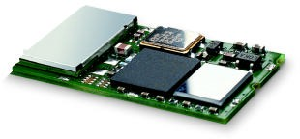


Bluetooth
Idea
Universal radio interface for ad-hoc wireless connectivity
Interconnecting computer and peripherals, handheld devices, PDAs, cell phones – replacement of IrDA
Embedded in other devices, goal: 5€/device (2005: 40€/USB bluetooth)
Short range (10 m), low power consumption, license-free 2.45 GHz ISM
Voice and data transmission, approx. 1 Mbit/s gross data rate
One of the first modules (Ericsson).
Prof. Dr.-Ing. Jochen Schiller, http://www.jochenschiller.de/

Slide 59

Bluetooth
History
1994: Ericsson (Mattison/Haartsen), “MC-link” project
Renaming of the project: Bluetooth according to Harald “Blåtand” Gormsen [son of Gorm], King of Denmark in the 10th century
1998: foundation of Bluetooth SIG, www.bluetooth.org
1999: erection of a rune stone at Ercisson/Lund ;-)
(was:
)
2001: first consumer products for mass market, spec. version 1.1 released
2005: 5 million chips/week
Special Interest Group
Original founding members: Ericsson, Intel, IBM, Nokia, Toshiba
Added promoters: 3Com, Agere (was: Lucent), Microsoft, Motorola
> 2500 members
Common specification and certification of products
Prof. Dr.-Ing. Jochen Schiller, http://www.jochenschiller.de/

Slide 60
Characteristics
GHz ISM band, 79 (23) RF channels, 1 MHz carrier spacing
Channel 0: 2402 MHz … channel 78: 2480 MHz
G-FSK modulation, 1-100 mW transmit power
FHSS and TDD
Frequency hopping with 1600 hops/s
Hopping sequence in a pseudo random fashion, determined by a master
Time division duplex for send/receive separation
Voice link – SCO (Synchronous Connection Oriented)
FEC (forward error correction), no retransmission, 64 kbit/s duplex, point- to-point, circuit switched
Data link – ACL (Asynchronous ConnectionLess)
Asynchronous, fast acknowledge, point-to-multipoint, up to 433.9 kbit/s symmetric or 723.2/57.6 kbit/s asymmetric, packet switched
Topology
Overlapping piconets (stars) forming a scatternet
Prof. Dr.-Ing. Jochen Schiller, http://www.jochenschiller.de/

Slide 61
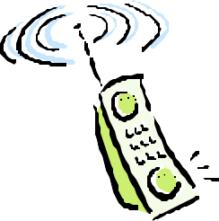
Piconet
Collection of devices connected in an ad hoc fashion
P
S
One unit acts as master and the others as slaves for the lifetime of the piconet
S
M
P
Master determines hopping pattern, slaves have to synchronize
SB
S
P
SB
Each piconet has a unique hopping pattern
Participation in a piconet = synchronization to hopping sequence
M=Master S=Slave
P=Parked SB=Standby
Each piconet has one master and up to 7 simultaneous slaves (> 200 could be parked)
Prof. Dr.-Ing. Jochen Schiller, http://www.jochenschiller.de/

Slide 62
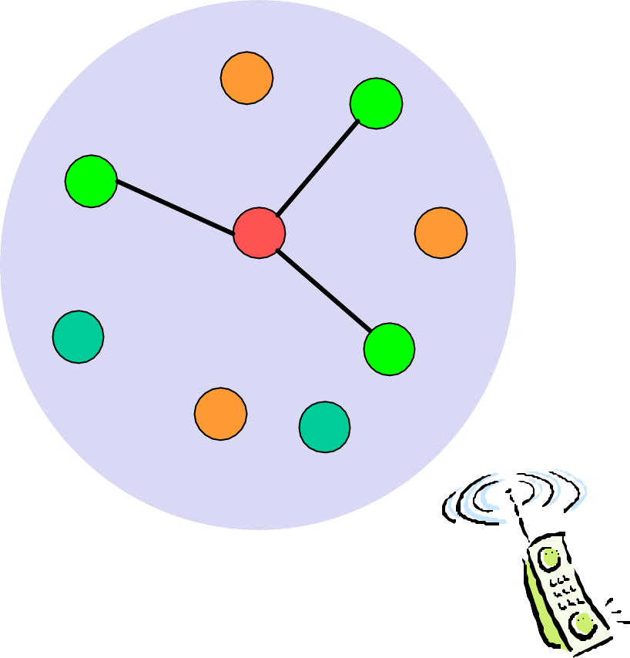
Forming a piconet
All devices in a piconet hop together
Master gives slaves its clock and device ID
Hopping pattern: determined by device ID (48 bit, unique worldwide)
Phase in hopping pattern determined by clock
Addressing
Active Member Address (AMA, 3 bit)
Parked Member Address (PMA, 8 bit)

P

·
S
SB

SB


S
 
SB

M
P
SB
SB




SB
S
SB



SB
P

SB
SB
SB
Prof. Dr.-Ing. Jochen Schiller, http://www.jochenschiller.de/

Slide 63
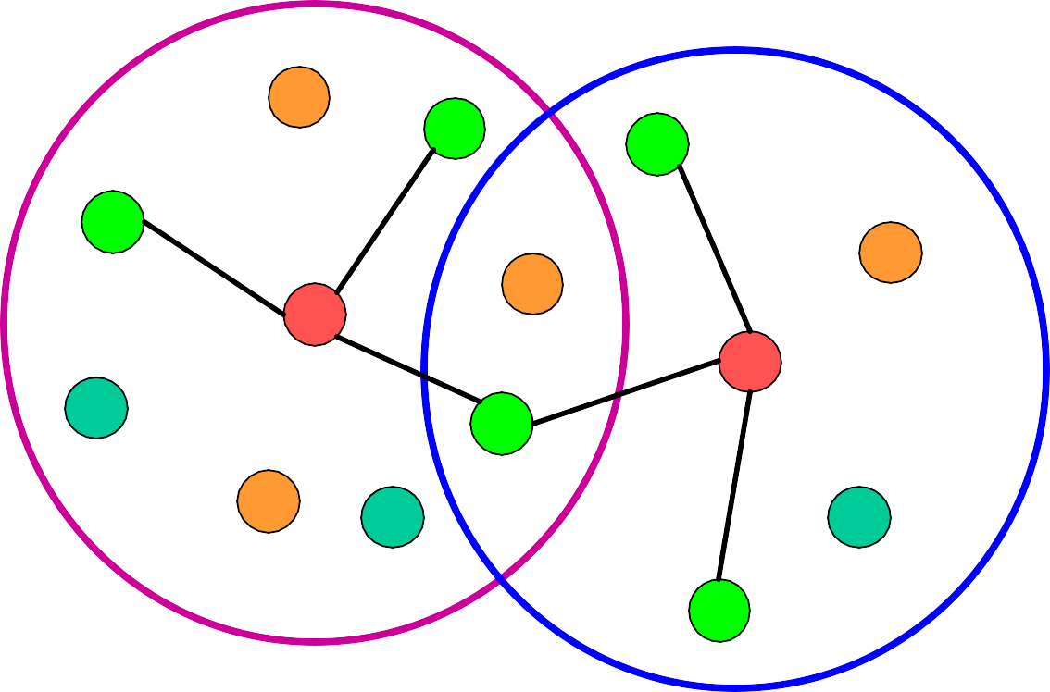
Scatternet
Linking of multiple co-located piconets through the sharing of common master or slave devices
Devices can be slave in one piconet and master of another
Communication between piconets
Devices jumping back and forth between the piconets
Piconets (each with a capacity of 720 kbit/s)
P
S
S
S
P
P
M
M
SB
S
M=Master S=Slave P=Parked SB=Standby
P
SB
SB
S
Prof. Dr.-Ing. Jochen Schiller, http://www.jochenschiller.de/

Slide 64
Bluetooth protocol stack
audio apps.
NW apps.
vCal/vCard
telephony apps.
mgmnt. apps.
TCP/UDP
OBEX
IP
AT modem commands
TCS BIN SDP
BNEP PPP
Control
RFCOMM (serial line interface)
Audio
Logical Link Control and Adaptation Protocol (L2CAP)
Host Controller Interface
Link Manager
Baseband
Radio
AT: attention sequence OBEX: object exchange
TCS BIN: telephony control protocol specification – binary
BNEP: Bluetooth network encapsulation protocol
SDP: service discovery protocol RFCOMM: radio frequency comm.
Prof. Dr.-Ing. Jochen Schiller, http://www.jochenschiller.de/

Slide 65
Bluetooth Protocol Stack
Radio: Specification of the air interface, i.e., frequencies, modulation, and transmit power
Baseband: Description of basic connection establishment, packet formats, timing, and basic QoS parameters
Link manager protocol: Link set-up and management between devices including security functions and parameter negotiation
Logical link control and adaptation protocol (L2CAP): Adaptation of higher layers to the baseband (connectionless and connection-oriented services,
Service discovery protocol: Device discovery in close proximity plus querying of service characteristics

Slide 66
Bluetooth Protocol Stack
Cable replacement protocol RFCOMM that emulates a serial line interface following the EIA-232 (formerly RS-232) standards. RFCOMM supports multiple serial ports over a single physical channel.
The telephony control protocol specification – binary (TCS BIN) describes a bit-oriented protocol that defines call control signaling for the establishment of voice and data calls between Bluetooth devices. It also describes mobility and group management functions. The host controller interface (HCI) between the baseband and L2CAP provides a command interface to the baseband controller and link manager, and access to the hardware status and control registers. The HCI can be seen as the hardware/software boundary.

Slide 67
L2CAP - Logical Link Control and Adaptation Protocol
Simple data link protocol on top of baseband
Connection oriented, connectionless, and signalling channels Protocol multiplexing
RFCOMM, SDP, telephony control
Segmentation & reassembly
Up to 64kbyte user data, 16 bit CRC used from baseband
QoS flow specification per channel
Follows RFC 1363, specifies delay, jitter, bursts, bandwidth
Group abstraction
Create/close group, add/remove member
Prof. Dr.-Ing. Jochen Schiller, http://www.jochenschiller.de/

Slide 68
Security architecture of Bluetooth
User input (initialization) Pairing
PIN (1-16 byte)
PIN (1-16 byte)
E₂
Authentication key generation (possibly permanent storage)
E₂
link key (128 bit)
Authentication
link key (128 bit)
E₃
Encryption key generation (temporary storage)
E₃
encryption key (128 bit)
Encryption
encryption key (128 bit)
Keystream generator
Keystream generator
payload key
Ciphering
Cipher data
payload key
Data
Data
Prof. Dr.-Ing. Jochen Schiller, http://www.jochenschiller.de/

Slide 69
LMP
Authentication, pairing, and encryption: Although basic authentication is handled in the baseband, LMP has to control the exchange of random numbers and signed responses.
Synchronization: Precise synchronization is of major importance within a Bluetooth network. The clock offset is updated each time a packet is received from the master. Additionally, special synchronization packets can be received.
Capability negotiation: Not all Bluetooth devices will support all features that are described in the standard, so devices have to agree the usage of, e.g., multi-slot packets, encryption, SCO links, voice encoding, park/sniff/hold mode (explained below), HV2/HV3 packets etc.
Quality of service negotiation: Different parameters control the QoS of a Bluetooth device at these lower layers. The poll interval, i.e., the maximum time between transmissions from a master to a particular slave, controls the latency and transfer capacity. Depending on the quality of the channel, DM or DH packets may be used (i.e., 2/3 FEC protection or no protection).
Power control: A Bluetooth device can measure the received signal strength. Depending on this signal level the device can direct the sender of the measured signal to increase or decrease its transmit power.

Slide 70
SDP – Service Discovery Protocol
Inquiry/response protocol for discovering services
Searching for and browsing services in radio proximity
Adapted to the highly dynamic environment
Can be complemented by others like SLP, Jini, Salutation, …
Defines discovery only, not the usage of services
Caching of discovered services
Gradual discovery
Prof. Dr.-Ing. Jochen Schiller, http://www.jochenschiller.de/

Slide 71
Additional protocols to support legacy protocols/apps.
RFCOMM
Emulation of a serial port (supports a large base of legacy applications)
Allows multiple ports over a single physical channel
Telephony Control Protocol Specification (TCS)
Call control (setup, release)
Group management
OBEX
Exchange of objects, IrDA replacement
WAP
Interacting with applications on cellular phones
Prof. Dr.-Ing. Jochen Schiller, http://www.jochenschiller.de/

Slide 72
Power management
. All devices being active must have the 3-bit active member address (AMA).
To save battery power, a Bluetooth device can go into one of three low power states:
Sniff state: The sniff state has the highest power consumption of the low power states. Here, the device listens to the piconet at a reduced rate (not on every other slot as is the case in the active state).
Hold state: The device does not release its AMA . If there is no activity in the piconet, the slave may either reduce power consumption or participate in another piconet.
Park state: In this state the device has the lowest duty cycle and the lowest power consumption. The device releases its AMA and receives a parked member address (PMA). The device is still a member of the piconet, but gives room for another device to become active

Slide 73
Zigbee
Zigbee is a standards-based wireless technology developed to enable low-cost, low-power wireless machine-to-machine (M2M) and internet of things (IoT) networks.
Zigbee is for low-data rate, low-power applications and is an open standard.
Zigbee products have been extended and customized by vendors and, thus, plagued by interoperability issues.
In contrast to Wi-Fi networks used to connect endpoints to high-speed networks, Zigbee supports much lower data rates and uses a mesh networking protocol to avoid hub devices and create a self-healing architecture.
IEEE 802.15.4 wireless standard for wireless personal area networks (WPANs). The Zigbee WPANs operate on 2.4 Ghz, 900 MHz and 868 MHz frequencies.

Slide 74
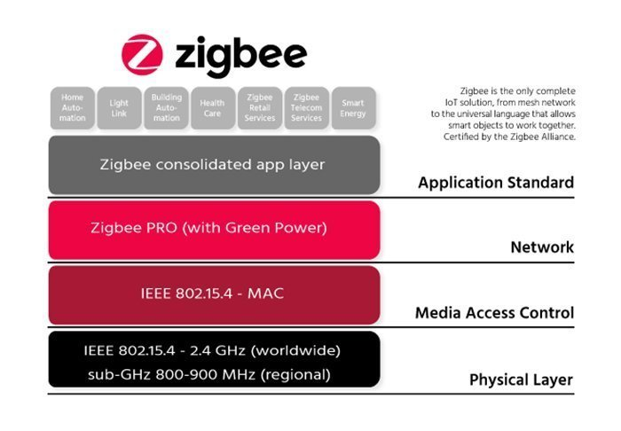
ZigBee Architecture
Zigbee Applications:
Home Automation
Medical Data Collection
Industrial Control Systems
meter reading system
light control system

Slide 75
Bluetooth v/s Zigbee
Bluetooth was developed under IEEE 802.15.1, which is used for providing wireless communication through radio signals. The frequency range supported in Bluetooth varies from 2.4 GHz to 2.483 GHz. It covers less distance than Zigbee. In Bluetooth, GFSK modulation technique is used.
Zigbee, BPSK and QPSK modulation techniques are used like UWB (Ultra-Wide Band). the frequency range supported in Zigbee is mostly 2.4 GHz worldwide, which means 2.4 GHz is not supported at all times. It covers more distance as compared with Bluetooth.
Bluetooth networks can be built using the point-to-point master-slave approach in which there is one master and up to seven slaves form a piconet, which leads to forming a scatter net which is a linking of two or more piconets. | Zigbee devices can be networked in a variety of generic topologies, including a star, mesh, and others. A cluster can be created by connecting different Zigbee-based network topologies. Zigbee Coordinator, Zigbee Router, and Zigbee Endpoint nodes make up any Zigbee network.

